Slide 1
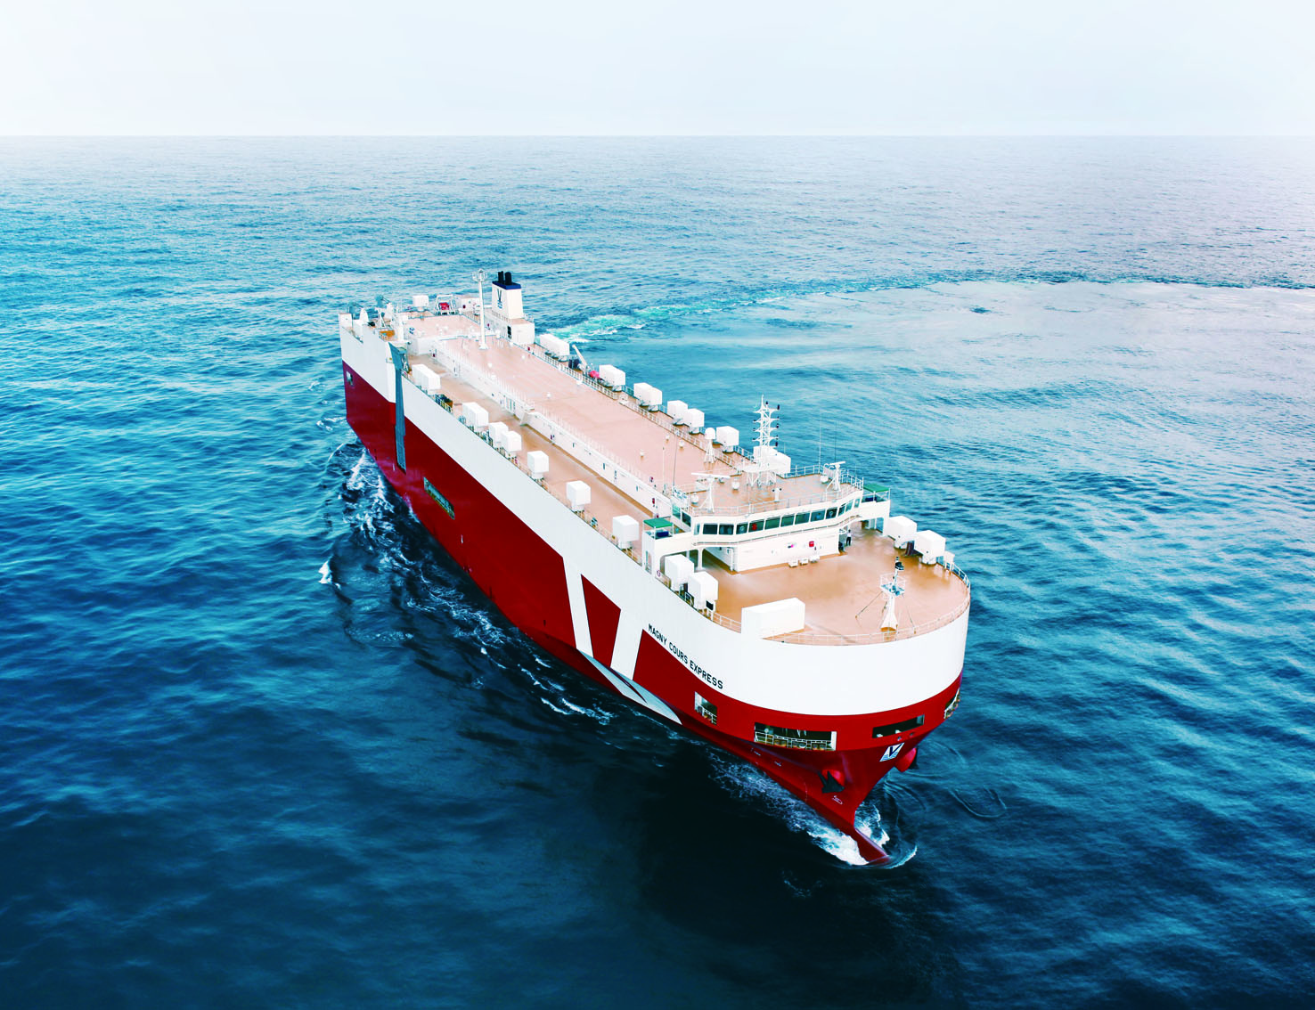
HYUNDAI
MIPO
DOCKYARD
February 2015

Slide 2
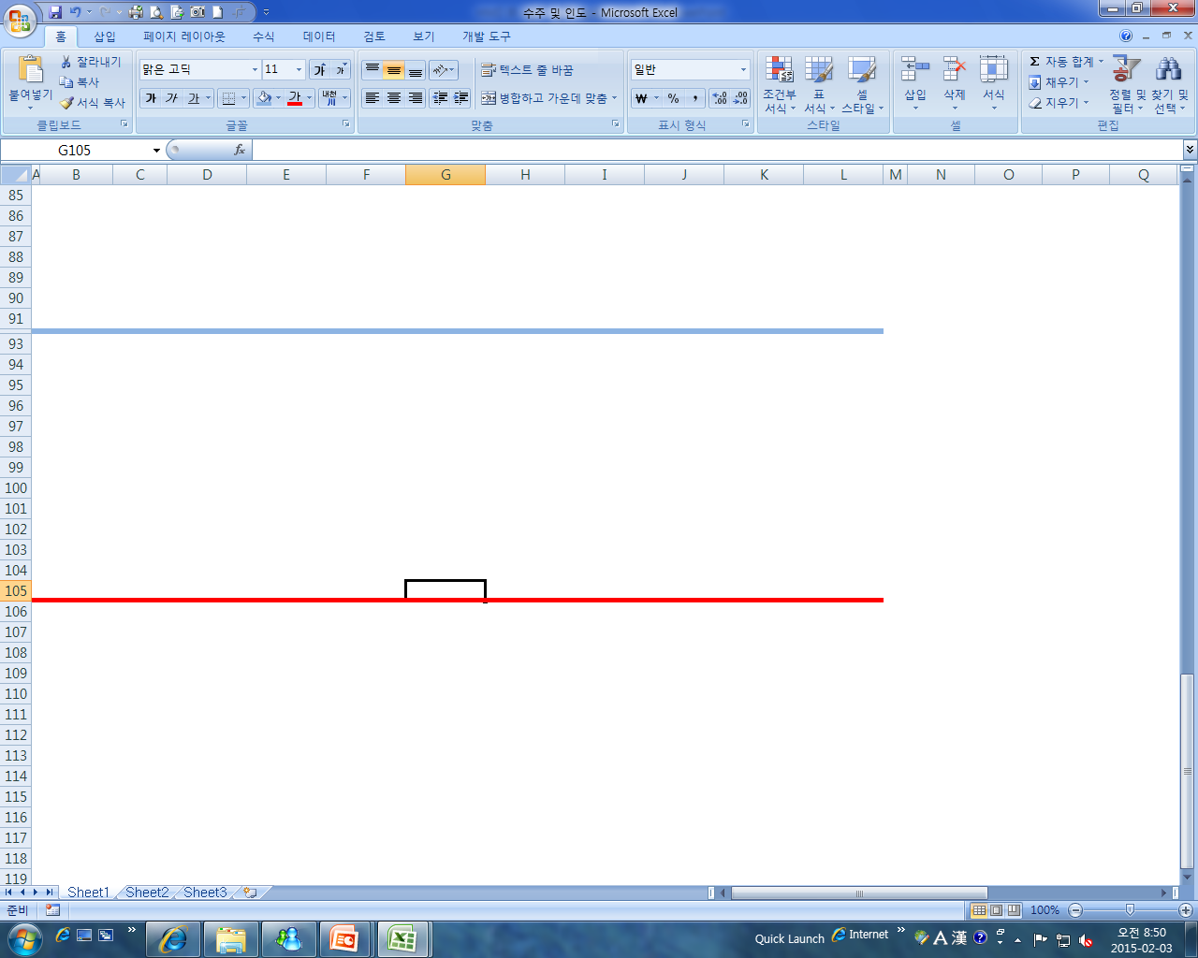

Contents
Company Overview
Production Facility
Financial Results
Income Statement
Balance Sheet
Order & Delivery
Perspectives
HVS

Slide 3
Company Overview
Shareholder Structure
Date of Establishment : 1975. 4. 28
Date of Listing : 1983. 12. 20
Number of issued stocks : 20,000,000
Paid-in Capital : KRW 100 bil.
Market Value : KRW 1,544 bil.
Credit rating : A1(CP), AA-(Corporate bond)
Number of employees : 3,897명
Number of dry docks : 4 (HMD), 2 (HVS)

Slide 4

Production Facility
 |  |  | NO.1 | NO.2 | NO.3 | NO.4
Hyundai Mipo | Dry Dock | Dimension | 380m x 65m | 380m x 65m | 380m x 65m | 295m x 76m
 |  | Capacity | 400,000 DWT | 400,000 DWT | 400,000 DWT | 350,000 DWT
 |  | Crane | 200 ton x 6 |  | 200 ton x 6
 | Quay | Length | 720m | 195m | 870m | 480m
 |  | Crane | 30 ton x 3 20 ton x 1 | 20 ton x 1 | 30 ton x 4 | Tower crane
Hyundai Vinashin | Dry Dock | Dimension | 260m x 45m | 380m x 65m | - | -
 |  | Capacity | 80,000 DWT | 400,000 DWT | - | -
 |  | Crane | 250 ton x 2 | 450 ton x 1 80 ton x1 30 ton x 1 | - | -
 | Quay | Length | 500m | 500m | 250m | 100m
 |  | Crane | 20 ton x 1 | 20 ton x 2 | 30 ton x 1 | 30 ton x 1

Slide 5
Financial Results
1) Non-Consolidated
2) Consolidated

Slide 6
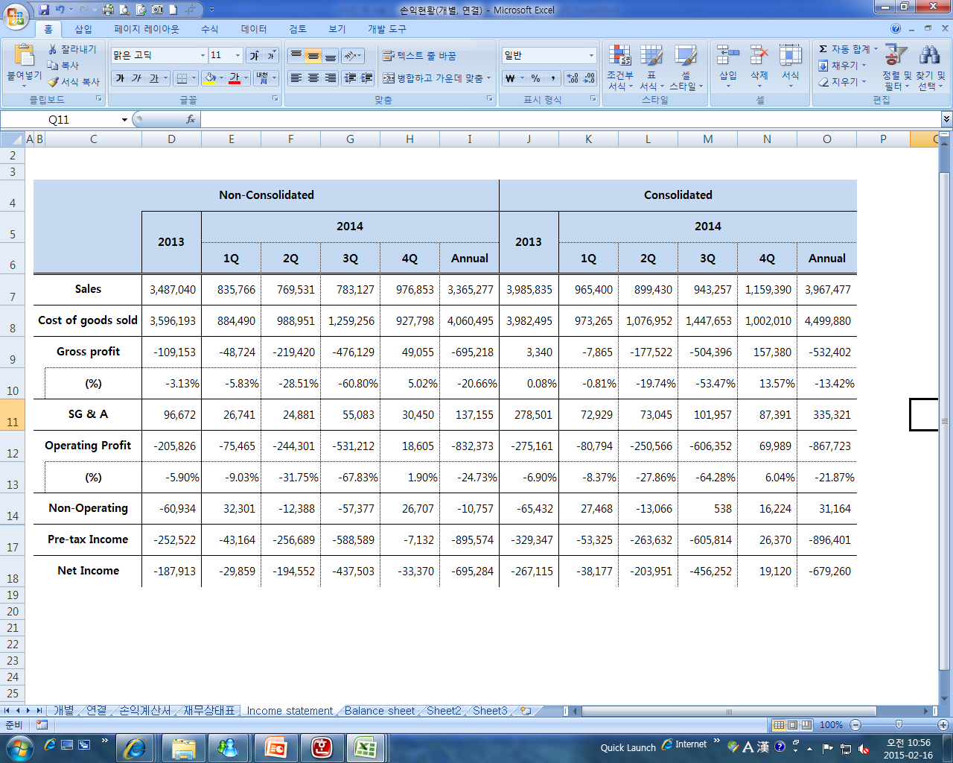
Income statement
(Unit : KRW Mil)

Slide 7
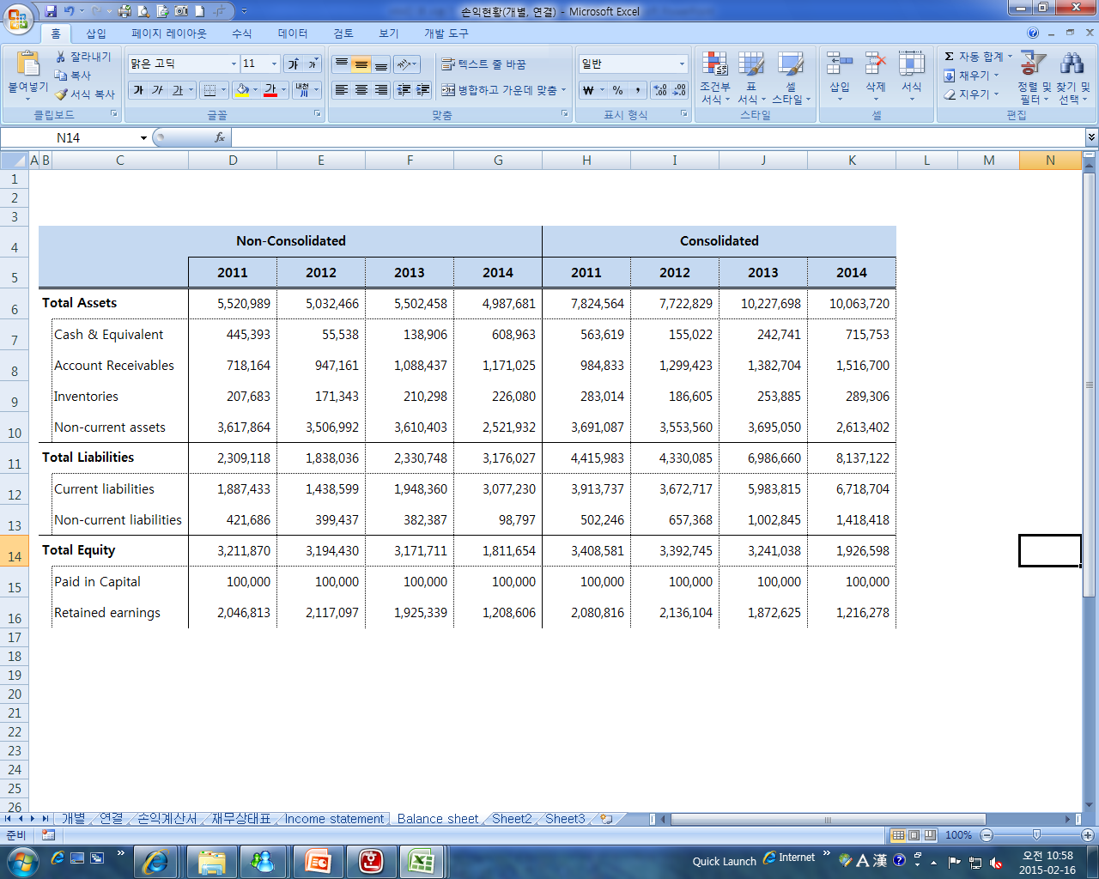
Balance Sheet
(Unit : KRW Mil)

Slide 8
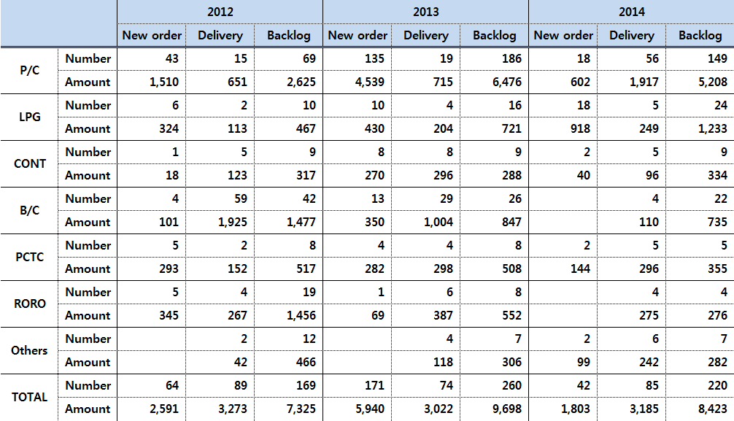
Order & Delivery
(Unit : $ Mil)

Slide 9
Perspectives
1. Steel plate price down-pressured
1) Steel plate price will go down in 2015 due to drop in material cost.
- Iron ore price has reached the lowest($63.30/ton) since global financial crisis in 2009.
2) Competition among steel makers drives price down.
- Price-competitive steel plates imported from China and Japan put more pressure.
3) HMD is likely to see its performance improve as the steel plate price goes down.
- Steel plate price occupies high proportion of the whole production costs.
- 10% decrease in steel plate price will lead to 1.5% rise in the operating profit.
2. Favorable currency rate for shipbuilders
1) The weak KRW against USD will be profitable for shipbuilders.
2) We expect the Bank of Korea to cut the benchmark interest rate in 2015 due to
lackluster domestic spending and declining exports to major markets.
3. Environmental Regulations
1) Strengthened environmental regulations will require to install additional equipments
such as EGR(Exhaust gas recirculation) and SCR(Selective catalytic reduction), which
has a influence to increase shipbuilding price.

Slide 10
Figure.2) Comparison between 2004 and 2014
Figure.1) Environmental Regulations
구분 |  | 2010 | 2011 | 2013 | 2015 | 2016 | 2017 | 2020 | 2025 | 2050
Sox (Sulfur) | ECA | 1.0% |  |  | 0.1%
 | Global | 4.5% | 3.5% |  |  |  |  | 0.5%
Nox (Nitrogen) (K/L) |  |  | Tier 2 (5%) |  |  | Tier 3 (0.1%)
Co2 |  |  |  |  | EEDI (10%) |  |  | EEDI (20%) | EEDI (30%) | EEDI (50%)
(Currency, Steel plate)
(ship price, WTI, o/p margin, GDP)

Slide 11
4. Market share of HMD (2013~2014)
1) While Chinese shipyards are provided the standardized ship design from state-run
design centers, HMD has about 1,000 skilled design personnel who can reflect the
needs of customer in a timely manner.
- SDARI: Shanghai design & research institute (One of Chinese ship design centers)
2) HMD strives to strengthen sales capacity through integration of HHI group sales
organization and secure an outstanding design workforce, which contributes to extend
the gap with competitors.

Slide 12
5. Comparison on the production facility
Shipyard | Facility | Type of Vessel
HMD | 3 dry dock - 380m X 65 X 12.5m, 400,000 DWT 1 dry dock - 295m X 76m X 12.5m, 350,000 DWT | 37K~52K PC Tanker 20K~38K LPG Carrier 7500 PCTC (or RO-RO) Handysize Bulk carrier
SPP | Sacheon: 1 dry dock (310m X 86m) Gosung: 1 floating dock (230m X 45m) | 50K/74K/113K PC tanker 59K/81K Bulk carrier 2,700/3,500 TEU Containership
Guangzhou | 2 Slipways (40,000 DWT, 60,000 DWT) 1 dry dock (50,000 DWT) | PC tanker (29K/35K/40K) Bulk carrier (25K/38K/44K)
STX(진해) | 1 dry dock (385m X 74m) 1 Skid berth (80,000 DWT) 1 floating dock (200,000 DWT) | LNG/LPG, Tanker, Containership, Bulk, PCTC FPSO, Drilling Rigs
Sungdong | 2 floating dock - 230m X 55m X 22.7m - 320m X 67m X 23m | 27K~180K Bulk carrier 115K/158K Oil tanker 3,600/6,500/8,800 TEU Containership
Jiangnan | 3 dry dock - 232m X 40m X 11.7m (80,000 DWT) - 184m X 24m X 9.1m (25,000 DWT) - 240m X 40m X 12.35m (70,000 DWT) | 20K~40K LPG carrier Car carrier Handysize bulk carrier
Sinopacific | 1 dry dock (425m X 84m X 13m) 80,000 DWT Slipways (280m X 45m) 50,000 DWT Slipways (284m X 20m) | 58K/63K/82K/121K Bulk carrier Offshore support vessel 20K LPG

Slide 13
HVS
Company Overview
Shareholder Structure
Date of Establishment: 1996. 3. 22
Local Partner: Vietnam Shipbuilding Union
Paid-in Capital: $33,456,938
Dry dock: No.1(80K DWT), No.2(400K DWT)
Quay: 1.35KM
Number of employees;
3,294 (HVS: 3,246, HMD: 48)

Slide 14
Financial Results
(Unit : $ thousand )
 | 2010 | 2011 | 2012 | 2013 | 2014
Sales | 298,632 | 482,132 | 431,530 | 194,036 | 384,075
Operating Profit | 62,840 (21.04%) | 7,171 (1.49%) | -19,996 (-4.63%) | -56,469 (-29.10%) | -121,860 (-31.73%)
Net Income | 66,255 (22.19%) | 3,959 (0.82%) | -19,280 (-4.47%) | -54,628 (-28.15%) | -109,045 (-28.39%)

